Slide 1
INVESTMENTS
Week 6: Performance Measurement
Vikas Raman

Slide 2
Outline
Why measure performance?
different purposes, different circumstances, different beliefs, different measures
Measuring returns
time weighted vs. value weighted
The Classic measures:
Jensen, Treynor, Fama, Sharpe, Appraisal Ratio
timing ability
generalisation from a CAPM world
Statistical significance
is past performance a guide to future performance?
Incentive issues

Slide 3
Why measure?
Many purposes, many circumstances:
should I go for active or passive fund management?
do hedge funds (or private equity) funds generate returns that compensate for the risk?
should I hire this balanced equity fund manager or that one?
does this US chemicals fund manager have real skill?
what target should I set my fund manager, how should I pay her, and when should I sack her?
Some common problems:
need to measure against appropriate benchmark
need to allow for risk – beliefs about CAPM matter
Largely focus on quoted equity investment
reasonably liquid, understand drivers of risk and return

Slide 4
Abnormal returns
Compare actual returns with:
some peer group – is this relevant?
return that would be expected for that amount of risk according to some theory
For example, under single-factor CAPM, measure the risk taken by β against the market portfolio, and the abnormal return is:
AR_{t} = R_{t} – R_{F,t} – β[R_{M,t} – R_{F,t}]
abnormal return can be positive even if actual return is negative
under CAPM, abnormal return should average zero
May calculate before or after fees

Slide 5
Measuring returns
Most funds have inflows and outflows that are outside their control
way that these are handled can affect apparent performance
Example:
two funds, each start with $100
market goes up 50% in first year, down 50% in second year
fund A has inflow of $50 after 1 year, fund B has outflow of $50
cash flows:
Year 0 1 2 IRR
A -100 -50 +100¹ -22%
B -100 +50 +50 0%
IRR is value-weighted and benefits B who was lucky enough to have less money when the market declined
¹ Fund A value $150 after 1 year, then $50 added, so starts 2nd year with $200. Market halves, so left with $100 at end of second year. Fund B starts 2nd year with $100, so ends it with $50.

Slide 6
Time-weighted returns
To remove accident of when cash flows in and out, use time weighted returns
in example, both A and B made +50% in first year and –50% in the second
normally express the return as a compounded rate, so time-weighted average return is¹:
Time weighted return is the return experienced by person who has an investment in the fund over the whole time, without any cash additions or withdrawals
Issue of time versus value weighting more controversial with private equity funds where managers have control over drawdown (and return of investment)
¹ If the return in year t is r_{t} then the (time-weighted) average rate of return over T years is {(1+r₁)(1+r₂)…(1+r_{T})}^{1/T}

Slide 7
Mandate
Fund managers typically have a mandate that specifies objectives, range of assets, portfolio composition …
first level of performance measurement is to verify conformity with mandate
Will assume that portfolio is in conformity with mandate
and that risk exposure (total risk, beta) are at intended levels
so issue is how to correct return for risk

Slide 8
Systematic or total risk?
Total risk of portfolio P is the sum of systematic and idiosyncratic risk:
In correcting performance for risk, should one correct for systematic or total risk?
if fund is entire wealth (e.g. pension fund, charity endowment), beneficiary exposed to total risk of portfolio
if fund will be combined with others (e.g. hedge fund, multi-manager set-up) beneficiary free to offset/enhance market risk
In first case, compare fund with passive portfolio of same total risk, in second with passive portfolio of same market risk

Slide 9
Jensen’s measure
Definition:
Note: ex-post CAPM framework
Realised
return
P
Security
Market
Line
r_{P}
J_{P}
M
r_{M}
r_{f}
1
β_{P}
Beta

Slide 10
Jensen’s measure
Equals the difference between the return on the portfolio and the return on a passive portfolio with the same systematic risk
a “passive” portfolio is a combination of the market portfolio and the risk-free asset
Measures how well the manager can identify mispriced securities
in CAPM world, Jensen’s alpha equals zero over time on average

Slide 11
Comparing the returns on two portfolios
J_{Q} > J_{P}
Jensen’s measure implies Q outperforms P
but ... Q carries more systematic risk than P
so ... which portfolio is superior?
Realised
return
r_{Q}
Q
Security
Market
Line
P
x
r_{P}
x
r_{f}
β_{P}
β_{Q}
Beta

Slide 12
Comparing the returns on two portfolios
Combine P with risk-free asset to create R
R has the same systematic risk as Q, but a higher return
... therefore P is superior to Q
Realised
return
R
r_{R}
Security
Market
Line
r_{Q}
Q
P
r_{P}
r_{f}
β_{P}
β_{Q} = β_{R}
Beta

Slide 13
Treynor’s measure
Definition:
Slope of line joining P to risk-free asset is greater than slope of line joining Q to risk-free asset
therefore, P is superior to Q
Realised
return
slope = T_{P}
Q
r_{Q}
P
r_{P}
r_{f}
β_{P}
β_{Q}
beta

Slide 14
Treynor’s measure
Provides a measure of performance adjusted for systematic risk
Most diversified equity funds have betas close to unity, so little difference between Treynor and Jensen, but relevant for hedge funds
Similar pair of measures correcting for total risk

Slide 15
Fama’s measure
Definition:
Realised
return
Capital
Market
Line
P
r_{P}
F_{P}
r_{M}
M
r_{f}
σ_{M}
σ_{P}
Total risk

Slide 16
Fama’s measure
Equals the difference between the return on the portfolio and the return on a passive portfolio with the same total risk
Appropriate measure of performance for portfolio which is beneficiary’s entire wealth
If CAPM is correct, Fama’s measure will be negative on average unless portfolio is efficient – that is it does not have idiosyncratic risk

Slide 17
Sharpe’s measure
Definition:
Slope of line joining P to risk-free asset is greater than slope of line joining Q to risk-free asset
therefore, P is superior to Q
Realised
return
Q
r_{Q}
P
r_{P}
slope = S_{P}
r_{f}
σ_{P}
σ_{Q}
Total risk

Slide 18
Measure for measure ...
Jensen’s measure or Fama’s measure can be used to compare the performance of a portfolio with that of a risk-adjusted benchmark
Jensen’s measure adjusts for systematic risk
Fama’s measure adjusts for total risk
Treynor’s measure or Sharpe’s measure can be used to compare the performance of two or more portfolios with one another
Treynor’s measure gives the excess return per unit of systematic risk
Sharpe’s measure gives the excess return per unit of total risk

Slide 19
... and for good measure
Jensen
Fama
return
P
return
P
CML
SML
x
x
r_{f}
r_{f}
beta
sigma
Treynor
Sharpe
P
P
return
Q
return
Q
r_{f}
r_{f}
beta
sigma

Slide 20
A Final Measure
Perspective of broad believer in CAPM who accepts that some stocks are mispriced, and who can readily leverage up or down by borrowing/lending, and by going long/short the market (index fund)
Best definition of skill is excess return per unit of specific risk – called the Appraisal (or Information) ratio
numerator represents the benefit which arises from selecting particular stocks
denominator represents the cost of not having efficient (fully diversified) portfolio

Slide 21
So ... which measure DO we use?
Example: Two portfolios P, Q
If P or Q represent the investor’s entire portfolio, Sharpe’s measure is relevant and Q is superior to P
If P or Q is to be combined with the market index as part of an active strategy, the Appraisal Ratio is relevant and P is superior to Q
If P or Q is to be combined with other actively managed portfolios to form a fully-diversified portfolio, Treynor‘s measure is relevant and Q is superior to P

Slide 22
Market timing
A manager who thinks she can forecast when the market will do well and when it will do badly will shift in and out of the market accordingly
how to test whether the manager has market timing skills?
If the manager has timing skills, the beta of the portfolio will be higher when the return is higher
can tell by regressing portfolio beta on market excess return, or by regressing excess return on portfolio on excess return on market and on squared excess return:
r_{P} – r_{F} = a + b(r_{M} – r_{F}) + c(r_{M} – r_{F})² + ε
if c = 0, then no timing skills; and stock selection skills only if a > 0
if c > 0 and a ≥ 0, timing skills
Can get c > 0 but a < 0 without having any skills:
buy index call options (more later; idea is calls give you exposure on the upside, protection on the downside; option cost leads to a < 0)
or switch into equities when market goes up, back into bonds when it goes down

Slide 23
Market timing
Example:
r_{A} – r_{F} = 1% + 1.5(r_{M} – r_{F}) + 8(r_{M} – r_{F})² + ε_{A}
r_{B} – r_{F} = 1% + 1.5(r_{M} – r_{F}) + ε_{B}
Case 1: r_{M} – r_{F =} 2%
E(r_{A} – r_{F} ) = 4.32%; E(r_{B} – r_{F} ) = 4.00%
Case 2: r_{M} – r_{F =} -2%
E(r_{A} – r_{F} ) = -1.68%; E(r_{B} – r_{F} ) = -2.00%

Slide 24
Market Timing

Slide 25
Multiple Risk Factors
With different model for explaining returns (e.g. Fama French, or multi-asset CAPM) can readily generalise previous measures
for example, Jensen’s alpha is simply the intercept on regressing the excess return on the portfolio on the excess return on the market
with multiple reference portfolios get:
Example: (Fama-French 3 factor model based Abnormal Returns)
AR_{P} = R_{P} – {R_{F} + β₁[R_{M} – R_{F}]+β₂ [SMB]+β₃ [HML]}

Slide 26
Multiple Risk Factors
Use of inappropriate benchmark is dangerous
early academic work on mutual funds using S&P500 showed positive alpha, which was interpreted as showing manager skills
in fact, out-performance attributable to substantial exposure to small cap stocks that are under-represented in index and which out-performed
Evidence of multiple priced factors (eg value v growth)
if believe they represent sources of risk, should correct for them to get risk-adjusted return
if believe they simply represent higher returns, may still want to identify how much of performance is attributable to factor exposure and how much to security selection

Slide 27
Statistical significance
Ex-post returns used to evaluate performance
do they reflect the true ability of Fund Manager to select stocks or to practise market timing?
component of performance we cannot explain (“idiosyncratic risk”) has annual volatility of σ_{ε}
over N years, average abnormal return has standard deviation of σ_{ε}/√N
Suppose the manager has managed an average Jensen measure of J over the N years
J√N/σ_{ε} is a measure of the probability of the performance being due to luck
it is a t-statistic for the null hypothesis H₀: performance due to luck
It is also the average appraisal ratio x √N

Slide 28
Statistical significance
Example: an investment portfolio with σ_{ε} = 23% achieves abnormal returns of 7.7% each year.
For how many years must it do this for the abnormal performance to be statistically significant at the 5% significance level?
Need J√N/σ_{ε} > 2, so N > (2x23%/7.7%)² =36
so the Fund Manager must maintain this average level of performance over 36 years!

Slide 29
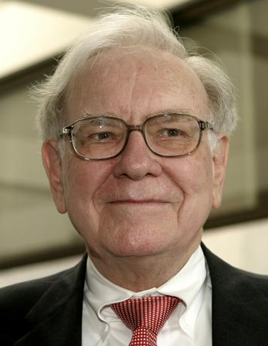
Warren Buffett
Whether we’re talking about socks or stocks, I like buying quality merchandise when it is marked down
– Warren Buffett, Berkshire Hathaway Inc., Annual Report, 2008.
A dollar invested in Berkshire Hathaway in November 1976 would have been worth more than $1500 at the end of 2011.
Over this time, Berkshire realized an average annual return of 19.0% in excess of the T-Bill rate, significantly outperforming the general stock market’s average excess return of 6.1%.
Source: Frazzini, Kabiller and Pedersen, 2012

Slide 30
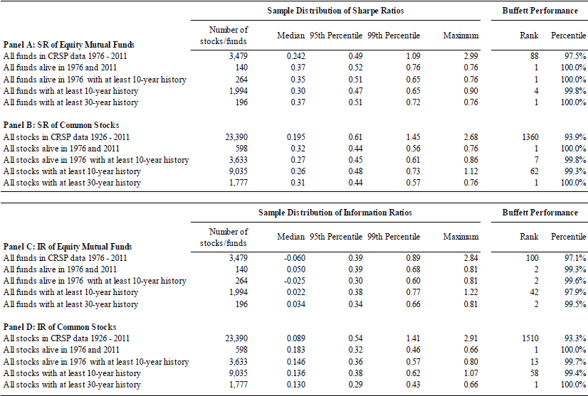
Warren Buffett
Source: Frazzini, Kabiller and Pedersen, 2012

Slide 31
Warren Buffett
Source: Frazzini, Kabiller and Pedersen, 2012

Slide 32
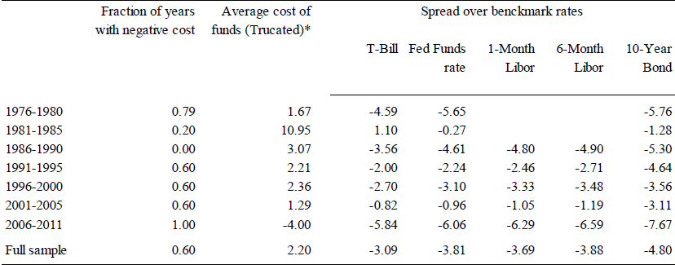
Warren Buffett
Buffett’s Cost of Leverage (Also read: ‘The secrets of Buffett’s success’, Economist,Sept-2012: http://www.economist.com/node/21563735)
Source: Frazzini, Kabiller and Pedersen, 2012

Slide 33
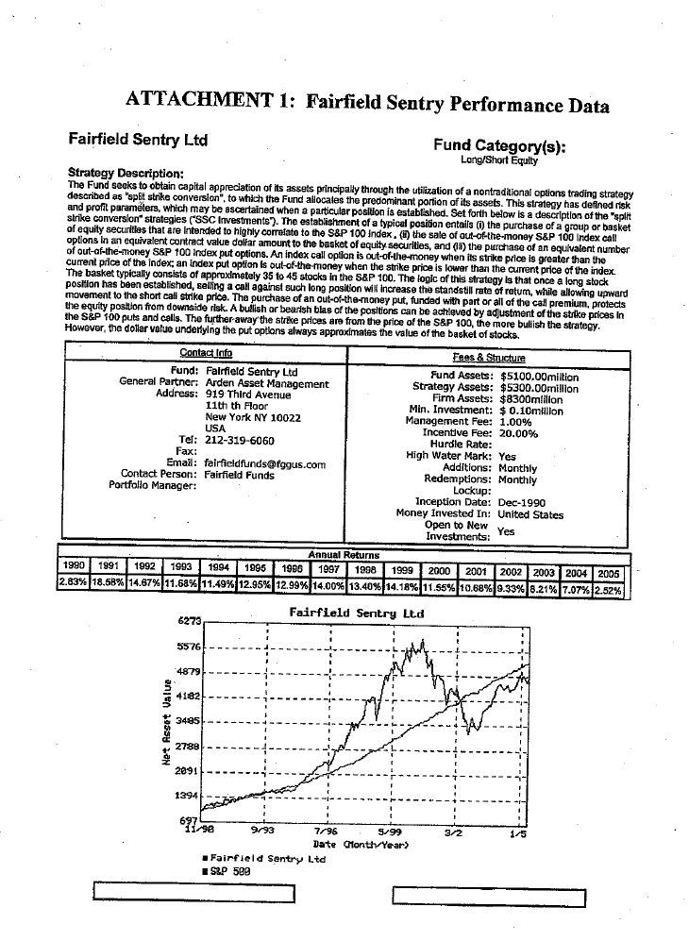
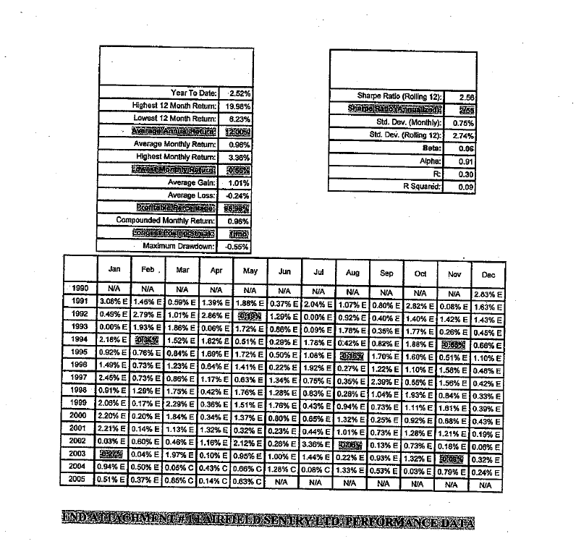
Fairfield Sentry

Slide 34
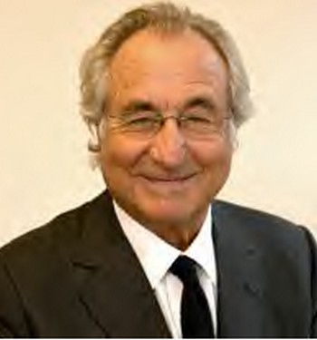
Bernie Madoff
Had cash channelled through a series of “feeder funds”
One of these was Fairfield Sentry that reported returns to shareholders after fees
Over 1990 to mid 2005, monthly performance showed average return 0.96%, beta 0.05, Jensen’s alpha 0.91%, total risk 0.75%
appraisal ratio of 0.91/0.75 = 1.21, over 185 months, gives a t-stat of 1.21 x √185 = 16.5
Can conclude that this sort of performance is certainly not due to luck
Bernie Madoff: prominent financier and philanthropist. Founder of BM securities and Chairman of NASDAQ.
Born NY 1938.
Ponzi scheme exposed 2008.
$65 billion losses (including fabricated gains).
Serving 150 years in jail

Slide 35
Implications of Statistical Power
Cannot normally expect to detect individual management skills purely from analysis of risk-adjusted performance
But can use in conjunction with declared philosophy to test consistency and plausibility
Can also use on populations of portfolios to ask questions about styles of investment, or persistence

Slide 36
Measurement and Incentives
Goodhart’s Law:
“When a measure becomes a target, it ceases to be a good measure” (Strathern 1997)
A measurement system that penalises risk will cause managers to take risks that are not measured
credit risk on bonds
writing options
illiquid or complex securities
is this what is wanted?

Slide 37
Summary
Performance measurement is used
on individual funds, to monitor managers’ performance
on groups of portfolios to evaluate styles of fund management
Important to distinguish what is within the Fund Manager’s control
use time-weighted returns
use appropriate benchmark portfolios
Important to adjust returns for risk
embodies appraiser’s view of risks for which compensation is needed
Measure performance using
Fama’s measure or Sharpe’s ratio if portfolio represents the entire investment
Appraisal ratio if portfolio is actively managed
Jensen’s measure or Treynor’s ratio if portfolio is part of a larger, fully-diversified portfolio

